Slide 1
2024 Committee Meeting Current Continuity in Auroral System Science: A 3D Modelling Approach to Current Closure in Non-Sheetlike Auroral Arcs
Jules van Irsel
Committee: Kristina Lynch, Yi-Hsin Liu, James Labelle, Matt Zettergren
Mar 4, 2024

Slide 2
Thesis Statement
The scope of this work will address the incomplete description of auroral arcs that stray from their basic, sheet-like morphology. The aim is to find physical, self-consistent solutions to the ionospheric current continuity equation using state-of-the-art ionospheric 3D modelling to provide insight into the role the ionosphere plays in MI coupling for less idealized auroral events. In particular, knowing the portions of FAC closed by Pedersen currents, which produce collisional Joule heating, versus Hall currents, which are non-dissipative, gives insight into the extent to which the ionosphere acts as a load to a magnetospheric generator. MI coupling demands self-consistent, topside maps of field-aligned current (FAC) and convection plasma flow that agree with a 3D ionospheric conductivity volume created by charged particle, auroral precipitation. This is why the auroral ionosphere plays a non-passive role in this coupling.

Slide 3


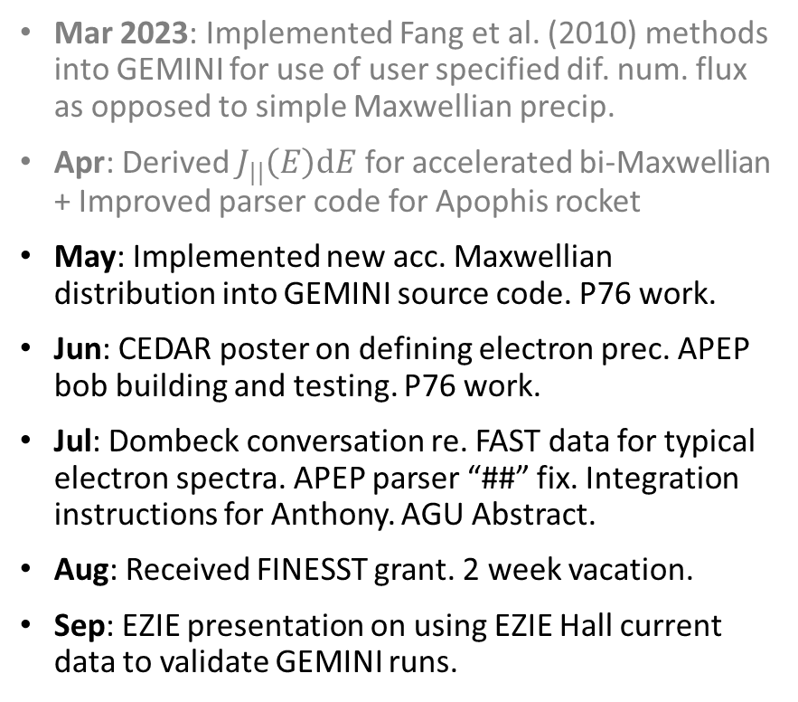



Progress Summary
Mar 2023: Implemented Fang et al. (2010) methods into GEMINI for use of user specified dif. num. flux as opposed to simple Maxwellian precip.
Apr: Derived $J_{||}\left(E\right)dE$ for accelerated bi-Maxwellian + Improved parser code for Apophis rocket
May: Implemented new acc. Maxwellian distribution into GEMINI source code. P76 work.
Jun: CEDAR poster on defining electron prec. APEP bob building and testing. P76 work.
Jul: Dombeck conversation re. FAST data for typical electron spectra. APEP parser “##” fix. Integration instructions for Anthony. AGU Abstract.
Aug: Received FINESST grant. 2 week vacation.
Sep: EZIE presentation on using EZIE Hall current data to validate GEMINI runs.
Oct: Started paper 1 on “reconstruction” (ARCS formalization) and “replication” for data driven catalog runs. Finding div-free flow = hard.
Nov: Automated use of GEMINI with Slurm for cluster computing. Organized matlab functions in prep for public use. Fix GEMINI boundary problems.
Dec: AGU poster on how to drive GEMINI with data driven runs for catalog using replication.
Jan 2024: Cold. APEP bob building. Lots of paper writing + figure making + code fixing. Running into flux conservation issues related to resolution.
Feb: Another cold. Almost finished paper 1 draft. First radar + swarm replication done. First run done on HEC.
Winter term: Mentoring an undergrad to take over certain aspects of GEMINI at Dartmouth.

Slide 4
Talk about paper
To make catalog of data driven runs, need ability to so
See paper
Reconstruction is for 2d extended CubeSwarm data
Replication is for 1-2 tracks of 1d data

Slide 5
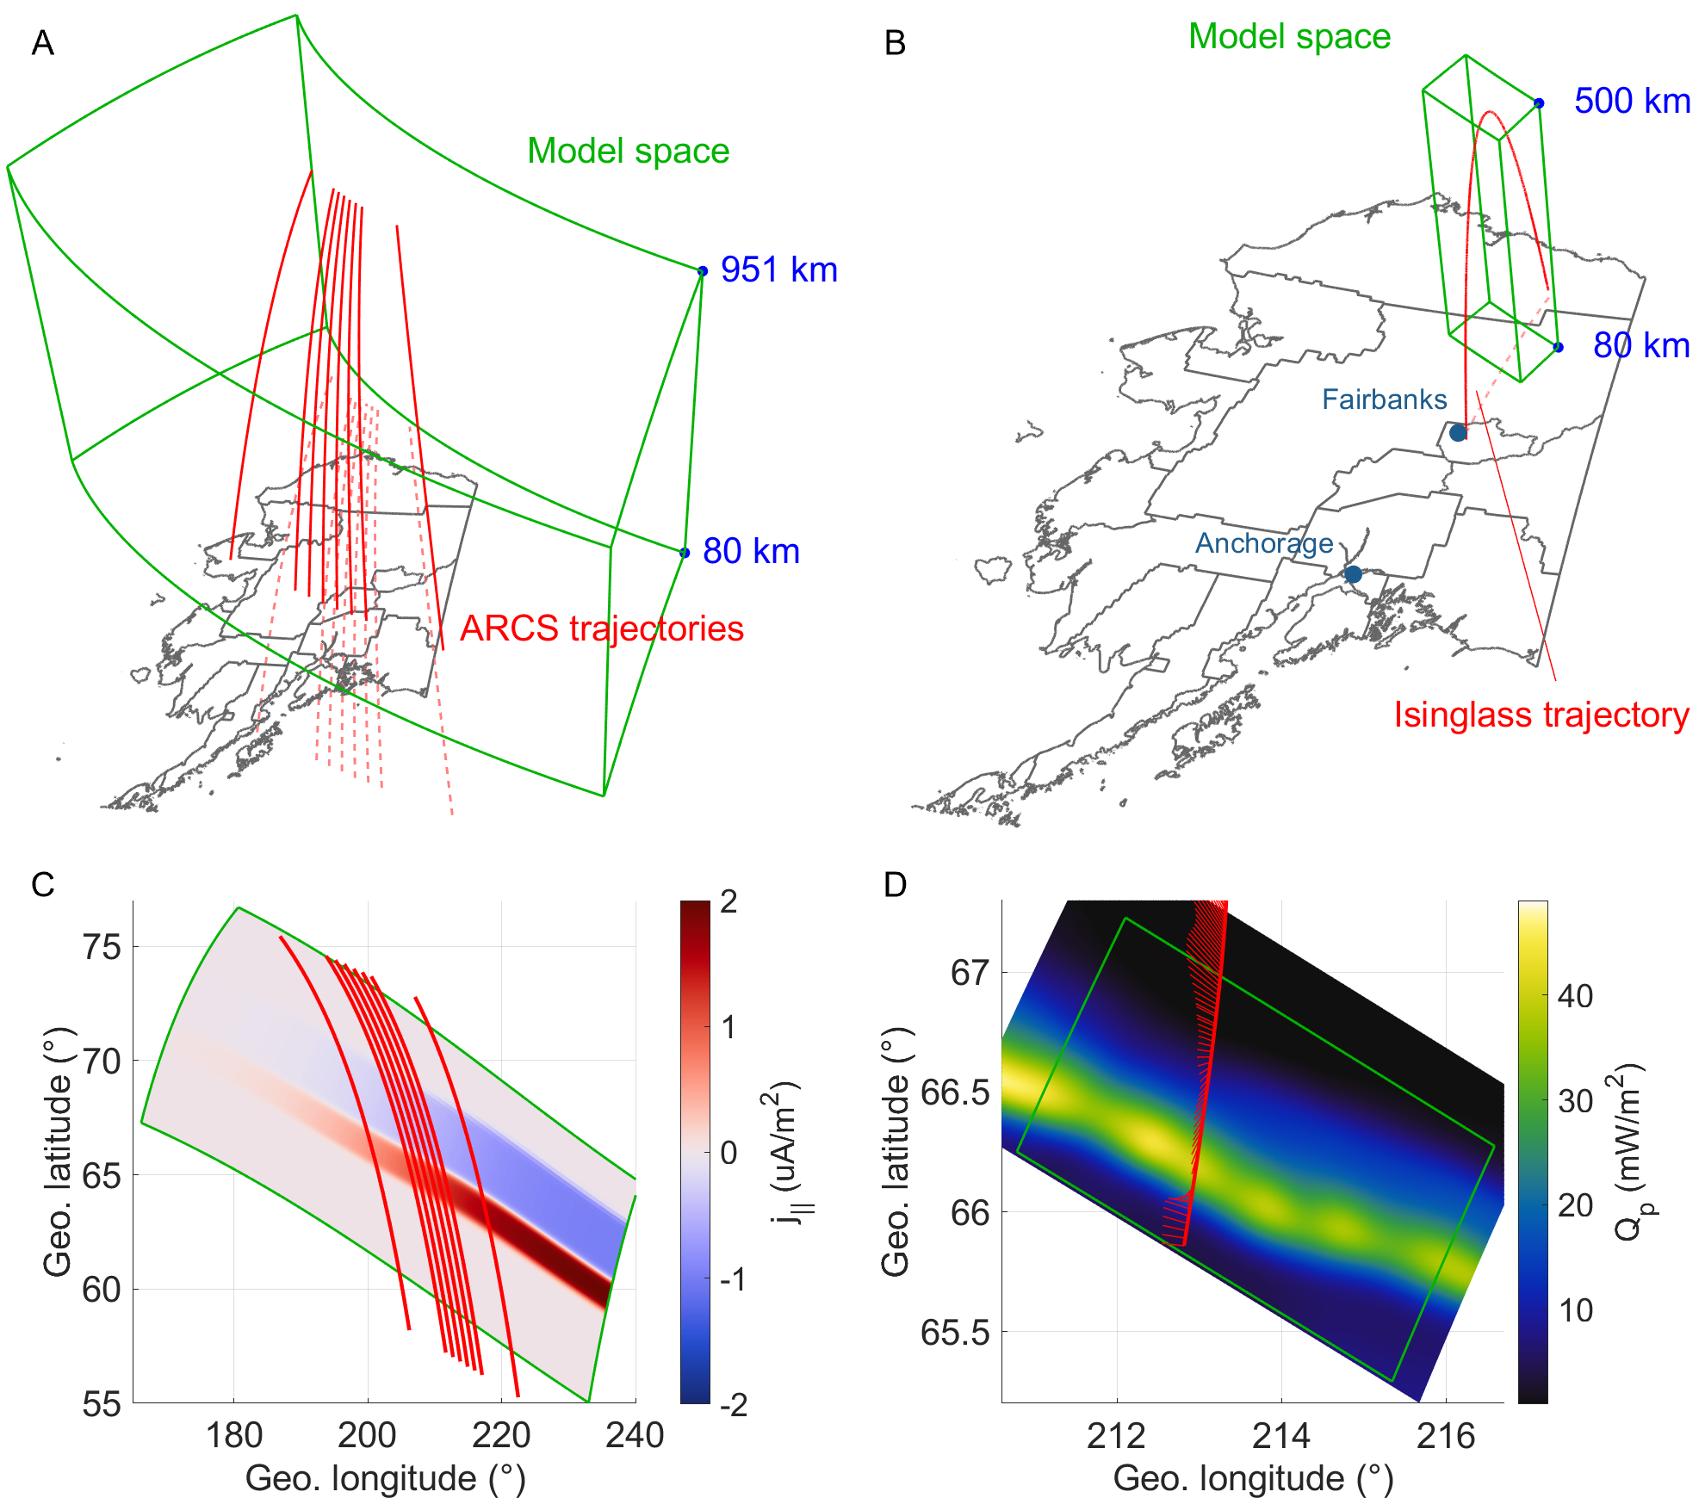

Slide 6
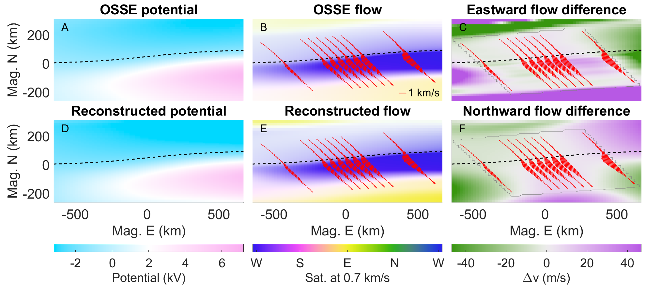

Slide 7
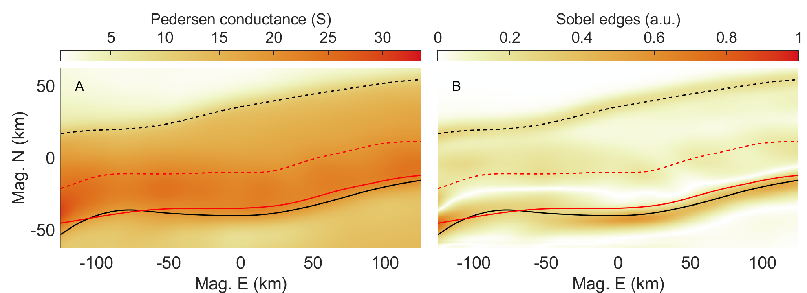
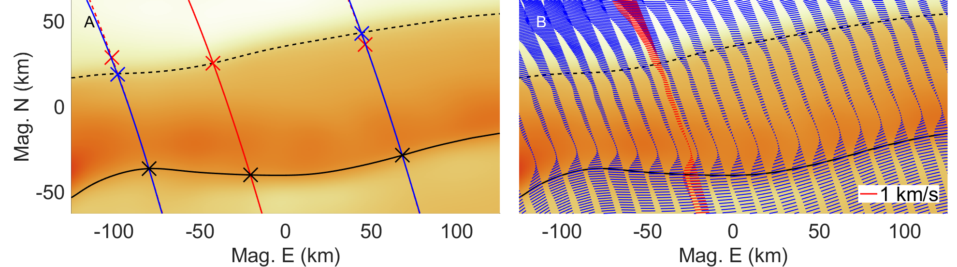

Slide 8
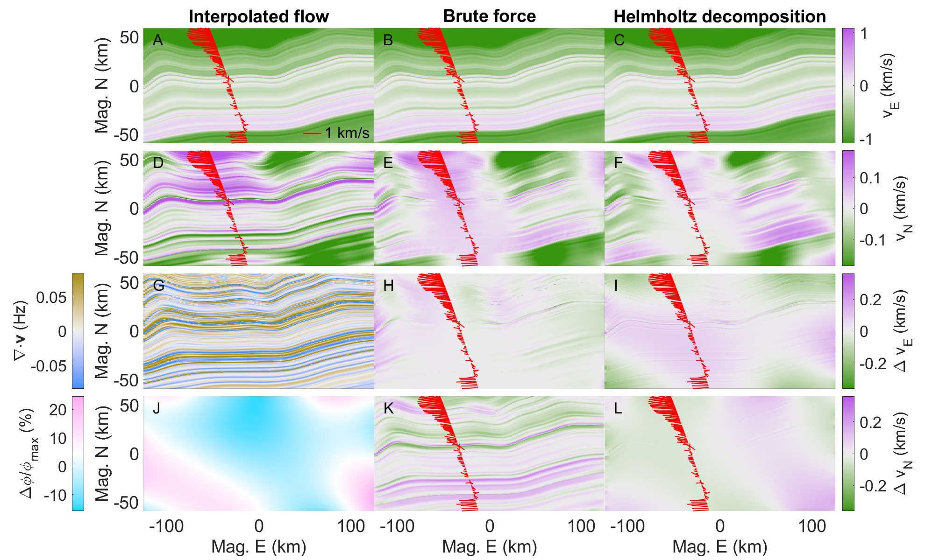

Slide 9
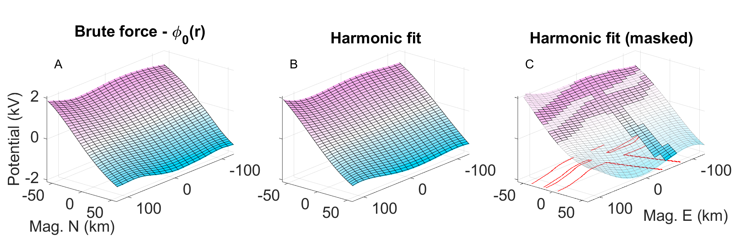

Slide 10
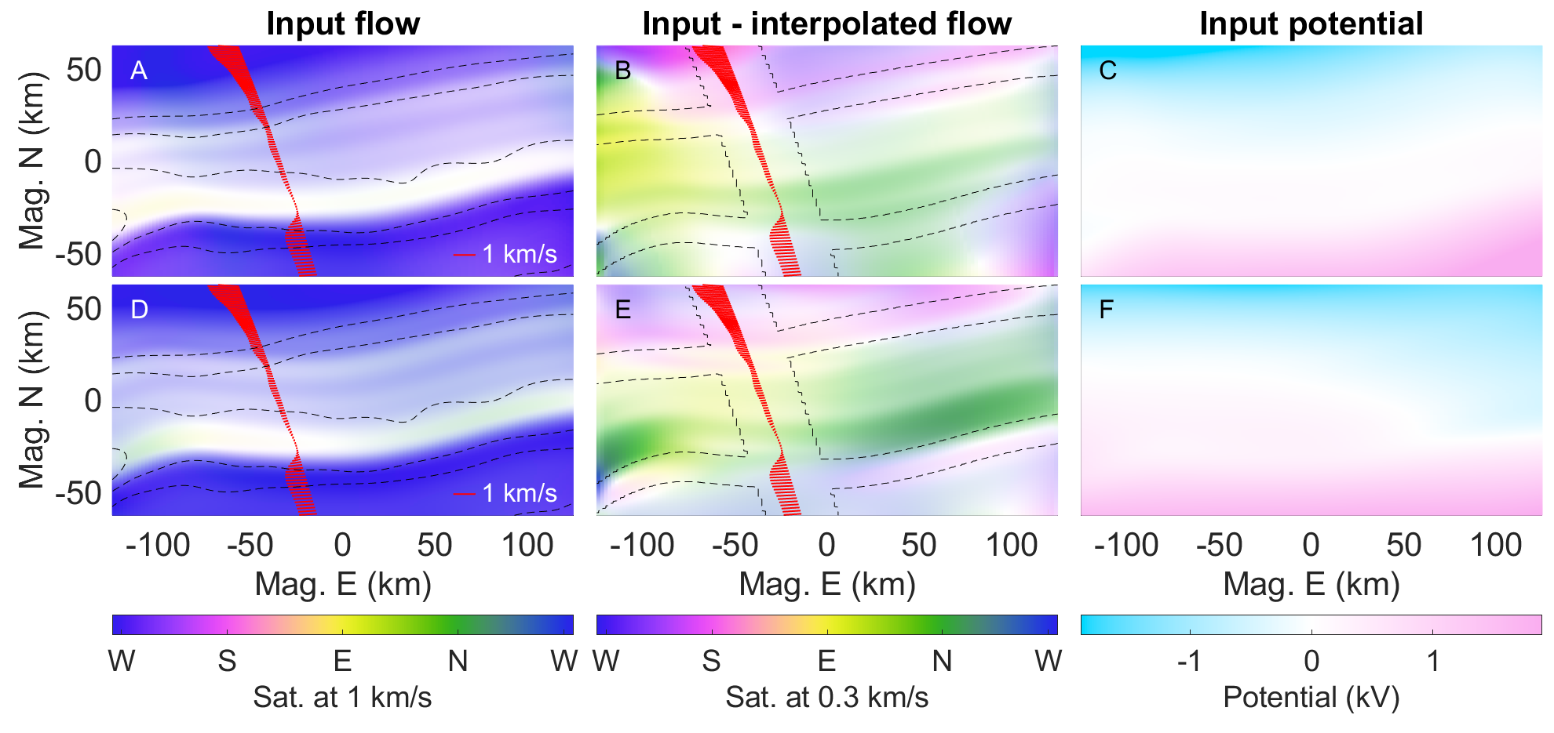

Slide 11
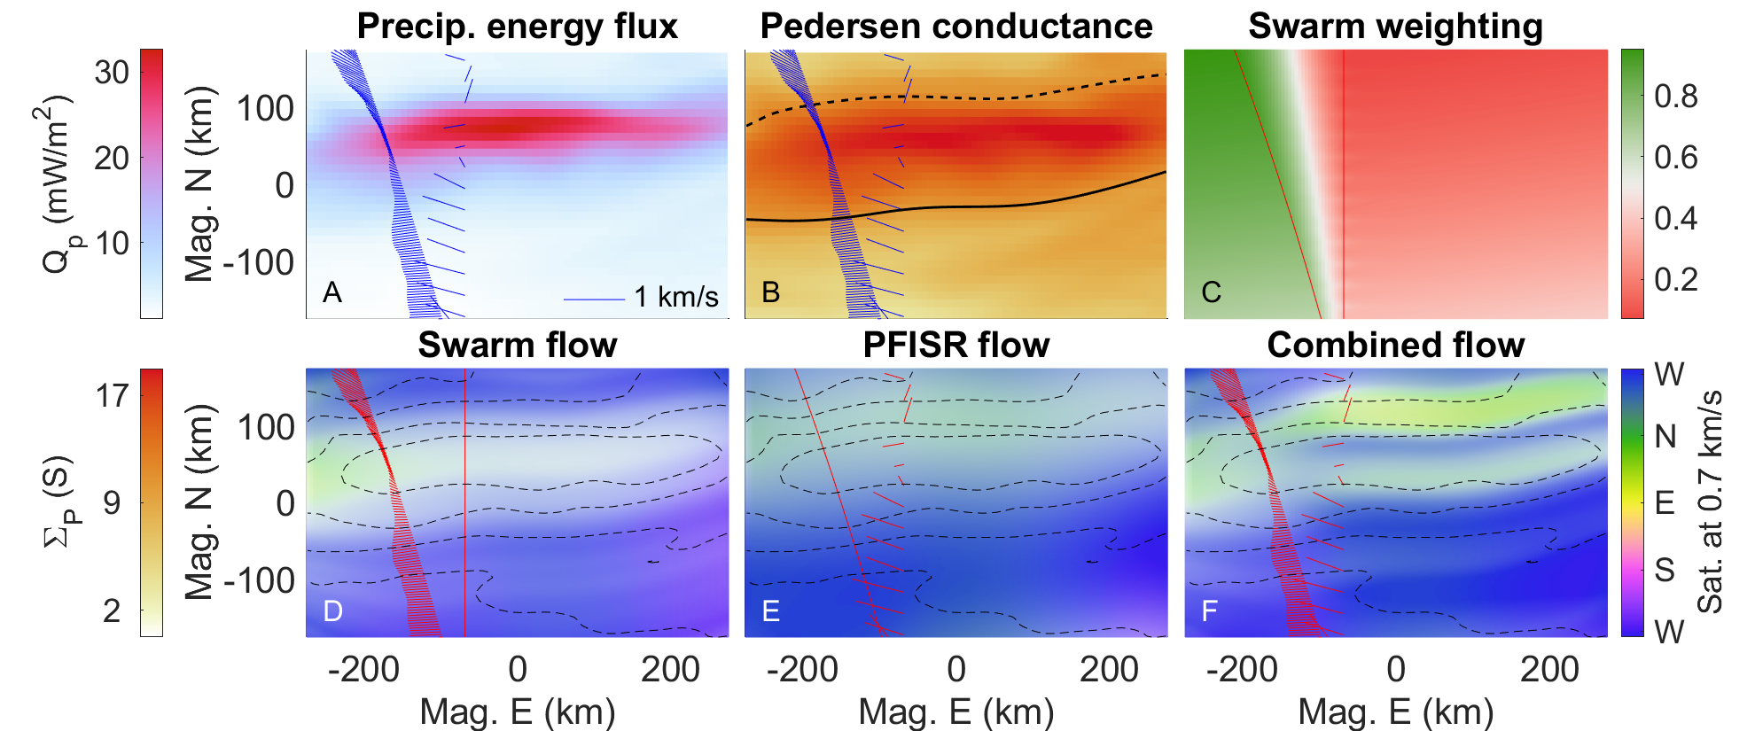

Slide 12
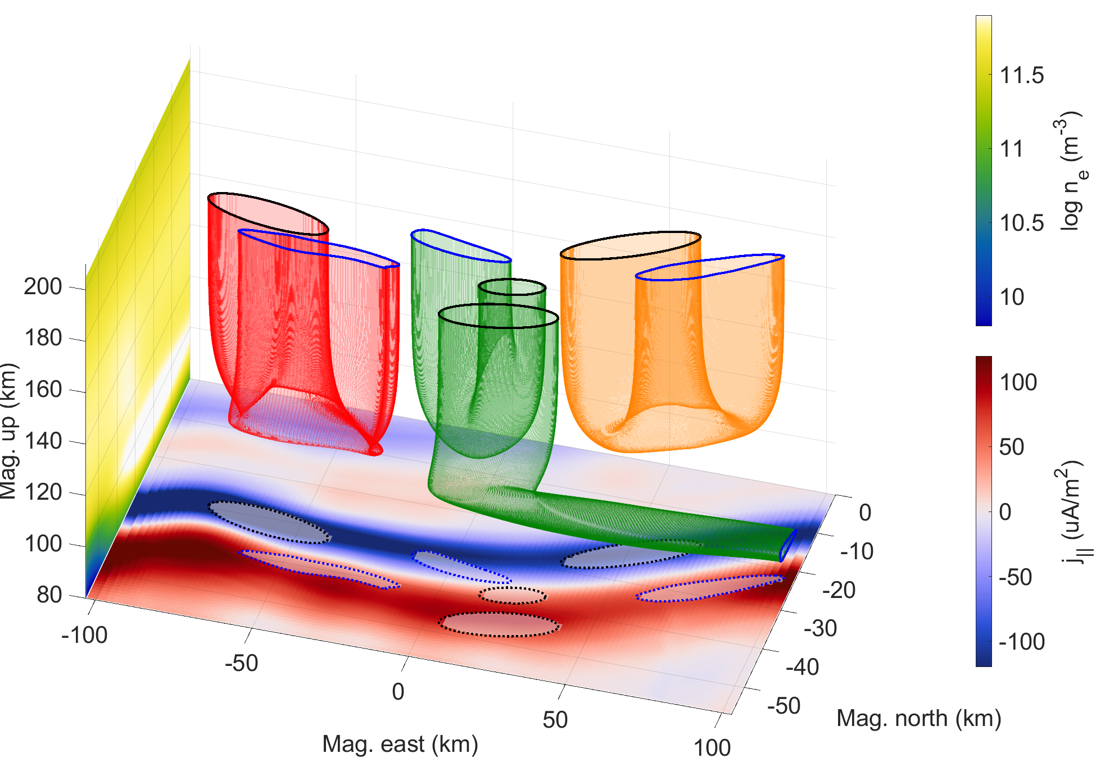

Slide 13
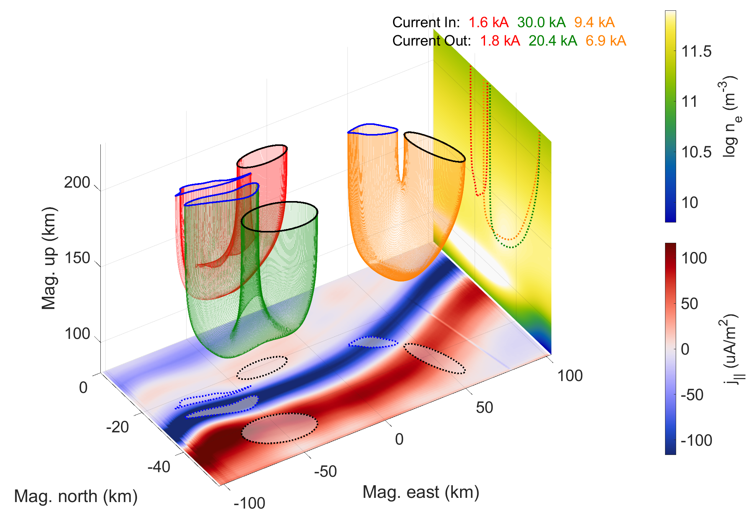

Slide 14
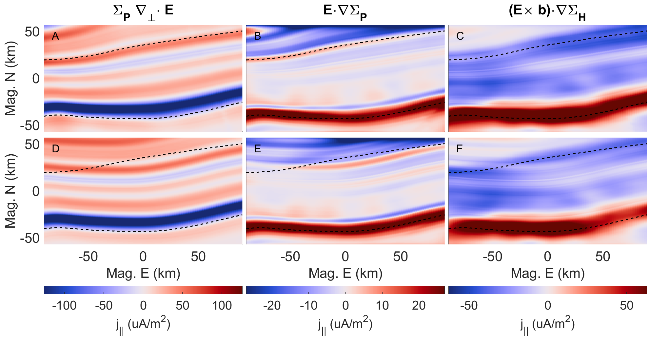

Slide 15

Future work from last meeting
Before Aug 2023
Add low energy tail to acc. Maxwellian through Evans (1974) or Meier (1989)
Push request new GEMINI code snippets to public
Write paper on 3D morphology findings
Aug 2023 – Aug 2024
Run ~1000 of GEMINI runs (10 categories x 10 parameters/category x 10 values per parameter)
Further develop tools for analyzing morphological parameters
Submit a paper on findings
Aug 2024 – Aug 2025
Gather and setup GEMINI to run with data drivers (DASC + rockets + SWARM)
Submit a paper on findings

Slide 16
Future work
Before Aug 2024
Submit reconstruction/replication paper
Set up to run simulations on HEC and resolve resolution issues
Write paper on 3D morphology findings (sensitivity study)
Aug 2024 – Aug 2025
Push request new GEMINI code snippets to public
Run ~1000 of GEMINI runs (10 categories x 10 parameters/category x 10 values per parameter)
Further develop tools for analyzing morphological parameters
Submit a paper on findings (filling out catalog, )

